Slide 1
Data Harmonization & Insights Extraction
NextHikes IT Solutions - Project 2
Chethana S Amresh

Slide 2
Project Overview: Data Harmonization and Insights Extraction
Objective:
The primary objective of this project is to consolidate, clean, standardize, and analyze disparate datasets from multiple sources to create a unified, consistent data environment. This harmonized data will serve as a foundation for generating actionable insights, enabling better decision-making and driving business value.

Slide 3
Introduction
What is Data Harmonization and Insights Extraction?
Data Harmonization: Standardizing and integrating data from multiple sources.
Insights Extraction: Analyzing harmonized data to uncover actionable insights.
Importance:
Ensures clean, consistent data for accurate decision-making.
Bridges the gap between raw data and strategic business decisions.
Raw data → Harmonization → Insights → Action.

Slide 4
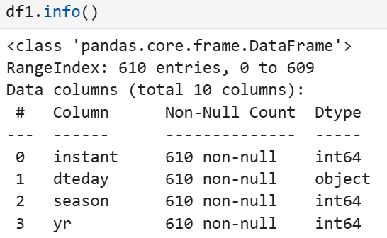
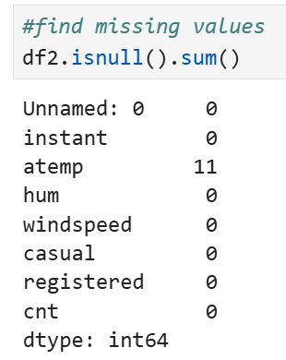
Challenges of unharmonized data
Inconsistent formats (e.g., date formats, units).
Duplicates, missing values, and errors.
Siloed data from multiple systems.

Slide 5
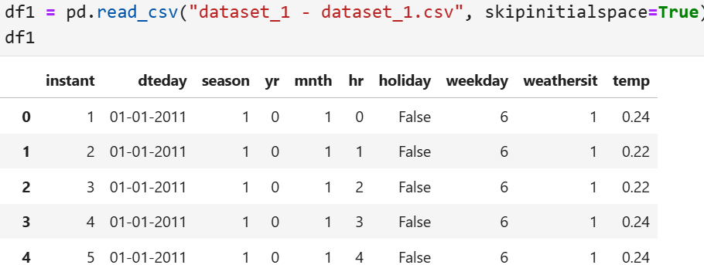
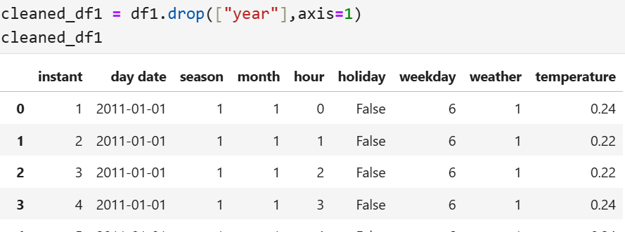
Benefits of harmonization
Clean, structured data ready for analysis.
Improved data quality and reliability.
Better integration across departments and systems.
Before cleaning
After cleaning

Slide 6
Steps in Data Harmonization
Data Collection: Gather data from diverse sources (databases, APIs, spreadsheets).
Data Cleaning: Remove duplicates, handle missing values, and correct errors.
Standardization: Align data formats, units, and field names.
Transformation: Reformat data to fit a unified schema.
Integration: Combine data into a single, cohesive dataset.
Metadata Management: Add documentation for data context.
Visuals:
Process diagram or pipeline visualization (e.g., ETL flow).

Slide 7
Steps in Insights Extraction
Exploration: Summarize data, visualize patterns, and identify trends.
Segmentation: Divide data into meaningful groups.
Statistical Analysis: Find relationships and test hypotheses.

Slide 8
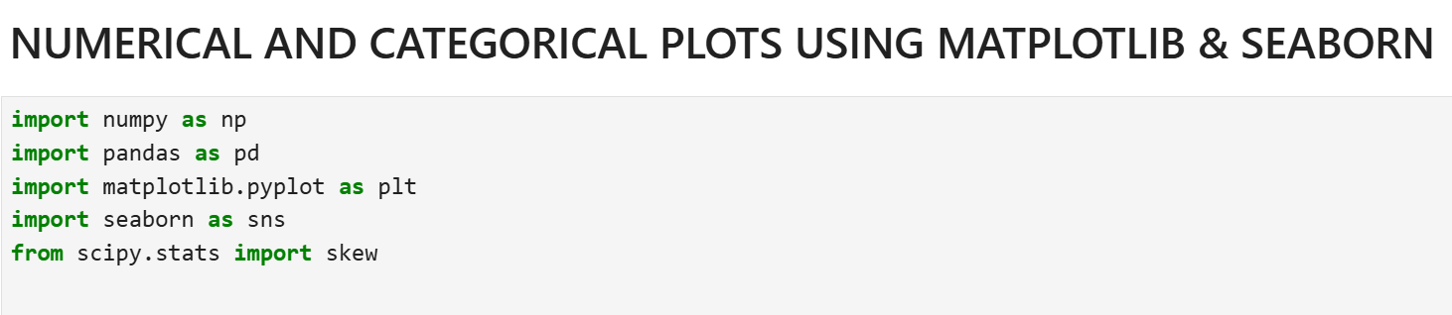
Tools for Insights Extraction
Tools and Technologies for Insight
Data Visualization: Matplotlib, Seaborn etc...

Slide 9
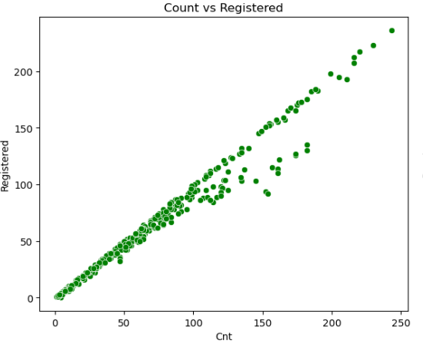
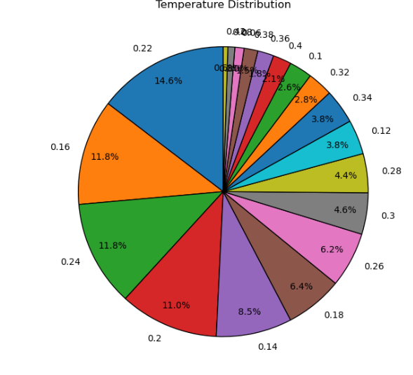
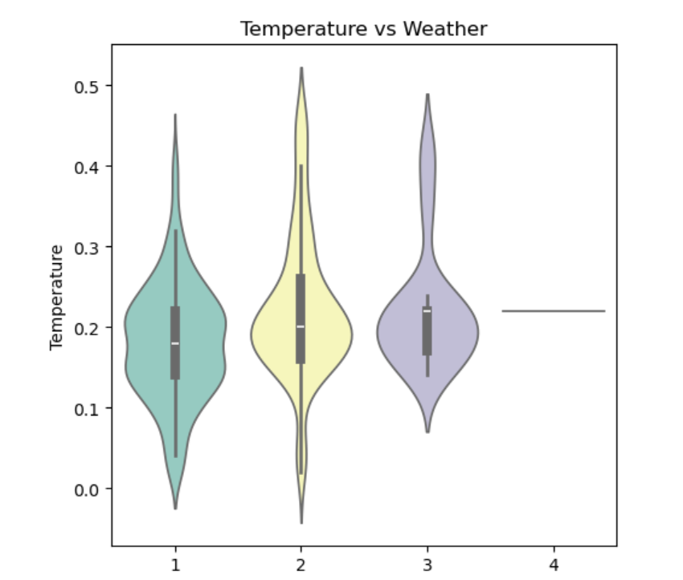
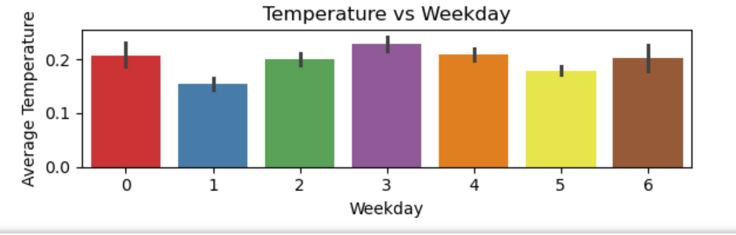
Visualizations(hist plot,pie plot,scatter plot,violin plot,bar plot)

Slide 10
Highlight Errors or Inconsistencies in Data
Outliers can help identify mistakes in the data collection, entry, or measurement process. These errors, once identified, can be corrected, improving the overall quality of the dataset.
Outliers may represent a small but important subset of data that differs from the majority. In certain cases, these subsets are worth studying in depth to identify new trends, behaviors, or market segments.
Example:
If a sensor records a temperature of 200°C in a room where the normal range is 20°C to 30°C, the outlier may indicate a faulty sensor or data entry error.

Slide 11
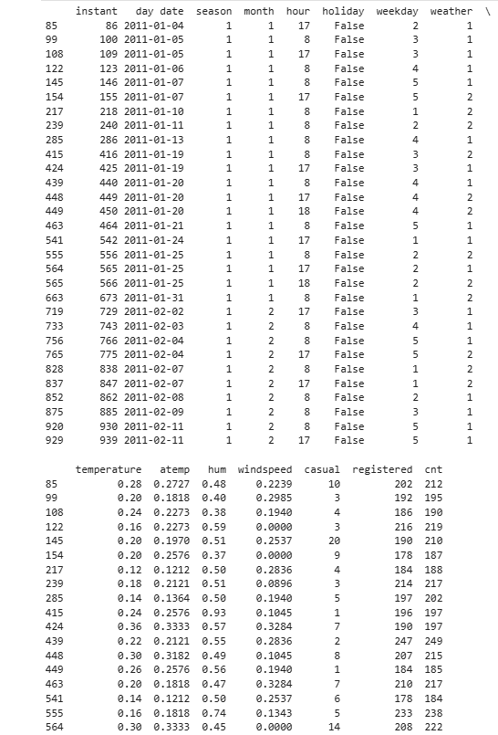
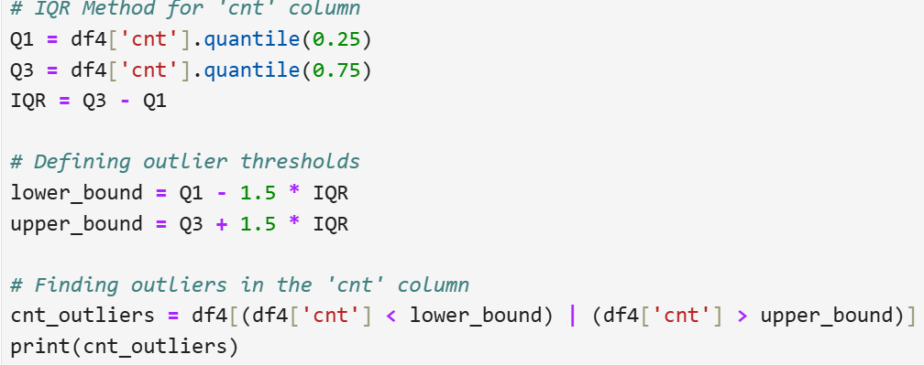
Outlier Detection

Slide 12
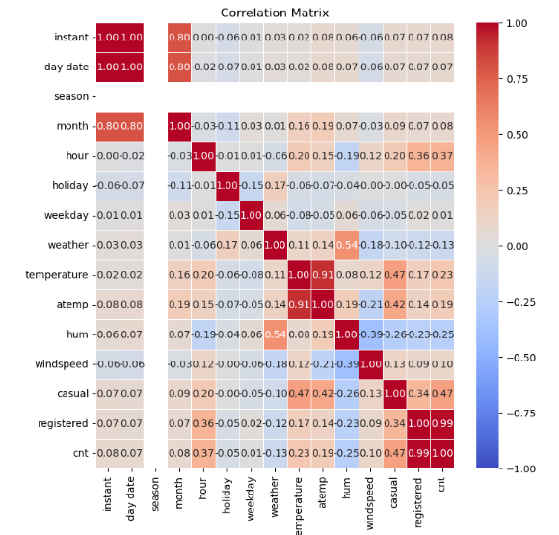
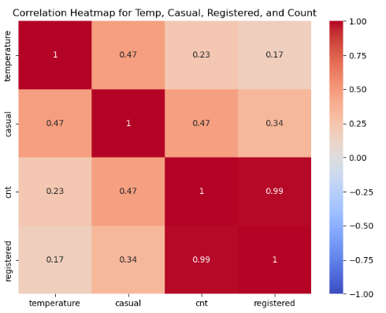
Heatmap & Correlation Matrix plot
Correlation Matrix
Heatmap

Slide 13
Benefits of Combining Harmonization & Insights
Improved Decision-Making: Reliable data leads to actionable insights.
Operational Efficiency: Faster, more accurate analysis.
Scalability: Easy integration with advanced analytics and machine learning.
Harmonization → Insights → Decisions → Business growth.

Slide 14
Conclusion
Data harmonization ensures clean and consistent data for analysis.
Insights extraction turns data into actionable recommendations.
Together, they enable data-driven decision-making and business growth.

Slide 15
THANK YOU

